Slide 1

Coaching and mentoring for capability building at RSL
Enhancing Professionalism and Reducing Conflict

Slide 2

Content List
Introduction
Current issues at RSL
Understanding coaching and mentoring
Benefits of coaching and mentoring
Relevance to RSL
Recommended coaching model
Coaching & mentoring actions for RSL
Expected outcomes
Challenges in implementing coaching & mentoring
Overcoming implementation challenges
Success indicators for RSL
Conclusion and recommendation
References

Slide 3

Introduction
Brief about RSL: A Sri Lankan traveling company that specializes in both outgoing and inbound travel services is Reise Sorover Ltd (RSL). RSL, which has been in business for just a little over seven years as well as was founded through two young entrepreneurs, has rapidly established a reputation for dependability and creativity. The company's youthful, vibrant staff, many of who joined with little to no prior industry experience, contributes innovation and zeal to the company. Professional interaction and cooperation are crucial to RSL's ongoing success because of the diverse range of stakeholders it interacts with, including government agencies, travel partners, lodging establishments, airlines, media outlets, and social media platforms.
Presentation aim: The purpose of this presentation is to suggest to Reise Sorover Ltd. (RSL) an organized coaching and mentoring program. Enhancing employee professionalism, lowering disputes between employees and others, and assisting young frontline managers in their long-term development into future leaders are the goals of this initiative. The objective is to establish a productive, growth-oriented workplace that complements the company's innovative culture and stakeholder expectations.

Slide 4

Current issues at RSL
Growing stakeholder Complaints: Young managers occasionally treat partners harshly or impolitely, which irritates important stakeholders.
Internal conflicts: Employees are competing more and more for promotions and recognition, which causes stress and less teamwork.
Lack of expert maturity: Poor interaction and decision-making are caused by the fact that many frontline managers lack industry experience.
Need for innovation: Innovation is required because, despite its existence, creativity is not sufficiently organized or encouraged to propel steady innovation in goods and services.
Limited professional development: At the moment, there is no official framework in place to mentor young workers toward leadership positions or career advancement.

Slide 5
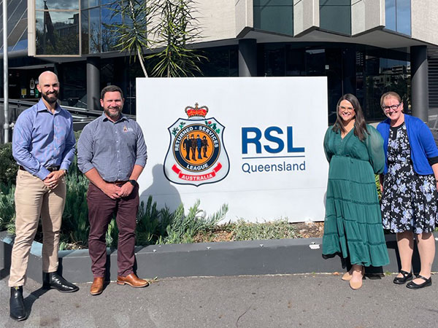
Understanding coaching and mentoring
Coaching:
A quick, performance-oriented procedure.
Aids workers in developing their abilities and achieving particular goals.
Usually carried out by a manager, coach, or supervisor.
Mentoring:
A relationship centered on long-term development.
Encourages both professional and personal development.
Usually entails a more seasoned individual mentoring a less seasoned one.
Key differences:
While mentoring is relationship-oriented, coaching is task-oriented.
While mentoring cultivates potential for the future, coaching enhances performance in the present.
While mentoring can be continuous and informal, coaching is formal and structured.

Slide 6

Benefits of coaching and mentoring
For employees:
Increases self-assurance and enhances communication abilities.
Improves one's capacity for making decisions and solving problems.
Offers advice on goal-setting and career development.
For the organization:
Encourages a courteous and professional workplace culture.
Enhances collaboration and lessens internal disputes.
Boosts productivity, retention, and employee engagement.
Cultivates the organization's future leaders.

Slide 7
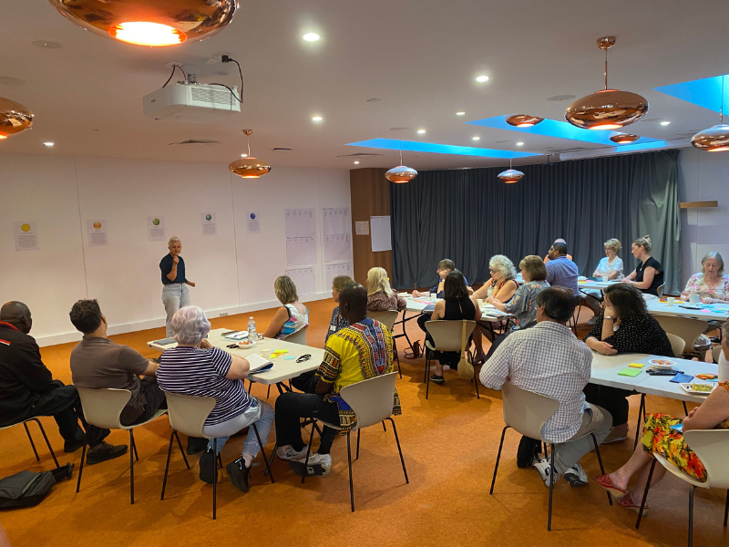
Relevance to RSL
Young Personnel Needs Guidance: Since many RSL staff members are inexperienced and new to the field, coaching and mentoring are crucial for developing skills.
Enhancing Stakeholder Relationships: In order to lower stakeholder complaints, coaching can assist young executives in improving their customer service and communication abilities.
Handling Internal Competition: Coaching can foster teamwork and lessen unhealthful rivalry among employees vying for attention.
Encouraging Innovation: Employees can transform innovative concepts into useful, value-adding services with the support of structured guidance.
Creating Future Leaders: By preparing young frontline executives for leadership roles, mentoring ensures the long-term viability of the company.

Slide 8

Recommended coaching model
G-Goal: Assist the worker in articulating their goals (e.g., enhance stakeholder communication).
R-Reality: Examine the existing circumstances and difficulties (such as recurring grievances or miscommunications).
O-Options: Talk about potential fixes or activities (such as role-playing, workshops on communication, or feedback sessions).
W-Way Forward: Choose the best course of action and make a commitment to precise actions with deadlines and follow-ups.
Why GROW?
It is straightforward, useful, and simple to use.
promotes accountability and self-awareness.
encourages ongoing education and performance enhancement.

Slide 9

Coaching & mentoring actions for RSL
Assign Mentors Internally: Young executives can receive career development, communication, and behavior guidance from senior or encountered staff members.
Hold coaching sessions once a month: Specialized coaching in areas such as conflict resolution, teamwork, and customer service.
Create a program for structured mentoring: Give each mentee specific objectives, deadlines, and progress reports.
Establish a culture of feedback: To promote development and accountability, mentors, instructors, and mentees should provide frequent feedback to one another.
Engage HR in progress monitoring: HR can monitor the results of mentoring, modify coaching programs, and guarantee alignment with corporate objectives.
Make use of actual work situations: Make mentoring and instruction useful and effective by incorporating learning into everyday tasks.

Slide 10

Expected outcomes
Enhanced professionalism: Young managers will improve their behavior, communication, and service standards.
Better stakeholder relationships: Professional and courteous communication will result in more robust external alliances and fewer grievances.
Decreased internal conflicts: By enhancing teamwork and interpersonal skills, coaching will lessen stress among employees.
Improved staff development: Mentoring will assist employees in establishing objectives, developing in their positions, and getting ready for leadership in the future.
Sustainable business growth: Long-term creativity and competitive advantage will be facilitated by a knowledgeable, driven workforce.

Slide 11

Challenges in implementing coaching & mentoring
Time Restrictions: Managers and staff may find it challenging to meet on a regular basis due to hectic schedules.
Absence of Competent Mentors/Coaches: Some team members might not have the education or experience necessary to mentor others successfully.
Employee Resistance: If not properly explained, some employees may view coaching as critique or coaching as superfluous.
Inconsistent Commitment: Some mentors or mentors might not give the process their all if there are unclear expectations.
Monitoring and Evaluation Challenges: Without the right tools or KPIs, it can be difficult to monitor progress and gauge the effectiveness of coaching or mentoring.

Slide 12

Overcoming implementation challenges
Plan Frequent Sessions: Establish predetermined times for coaching and mentoring to guarantee both parties' commitment and consistency.
Give coaches and mentors basic training: Give senior employees the coaching skills they need, including how to use models like GROW, give feedback, and actively listen.
Raise Employee Awareness: To allay employee apprehension, resistance, or misunderstanding, clearly communicate the goals and advantages of coaching and mentoring.
Align with Company Goals: To boost management support and relevance, tie coaching and mentoring results to performance targets.
Employ Easy Monitoring Tools: Use progress tracking sheets, feedback forms, and checklists to assess success and make necessary corrections.

Slide 13

Success indicators for RSL
Decrease in stakeholder complaints: Young employees' enhanced professionalism and communication skills ought to result in more favorable comments from partners and clients.
Better Collaboration and Teamwork: There are fewer internal disputes and departments work together more effectively.
Increased staff engagement and retention: When workers feel encouraged to advance, job satisfaction and attrition rates rise.
Development of visible leadership: Junior employees start to assume greater responsibility and exhibit leadership traits.
Increase in initiative and innovation: Workers feel more comfortable offering fresh suggestions for service enhancements and sharing innovative ideas.
Regular reachment of personal development objectives: Mentees demonstrate advancement in the areas that coaching and mentoring are intended to address.

Slide 14

Conclusion and recommendation
Conclusion:
In order to address RSL's current issues such as unprofessional behavior, an increase in conflicts, and a lack of structured development coaching and mentoring are crucial tools.
These procedures will help foster a positive workplace culture and get young executives ready for leadership roles in the future.
Recommendation:
Start with important departments like the inbound and Outbound communication Tours and implement a structured mentoring and coaching program for six months.
Coaching sessions should be guided by the GROW model.
To guarantee consistency, designate seasoned mentors and offer fundamental instruction.
Regular reviews, feedback, and performance metrics can be used to track progress.

Slide 15

References
Abeykoon, T. (2025). ENHANCING SUSTAINABLE GROWTH THROUGH COACHING AND MENTORING AT REISE SOROVER LTD (RSL). Retrieved from https://www.coursehero.com/file/222491020/Enhancing-Sustainable-Growth-through-Coaching-and-Mentoring-at-RSLpptx/
Bachkirova, T. (2020). Evaluating a Coaching and Mentoring Program. Retrieved from https://onlinelibrary.wiley.com/doi/abs/10.1002/9781119656913.ch19
College, C. S. (2025). The effects of coaching and mentoring on team development and effectiveness. Retrieved from https://www.civilservicecollege.org.uk/news-the-effects-of-coaching-and-mentoring-on-team-development-and-effectiveness-217
Garmon. (2025). What are MRSLs and RSLs? Retrieved from https://www.garmonchemicals.com/en/sustainability/mrsl-rsl
Hancock, J. (2025). The GROW Model of Coaching and Mentoring. Retrieved from https://www.personio.com/hr-lexicon/coaching-models/
Petruzzi, J. (2024). Coaching and Mentoring Resource Manual. Retrieved from https://www.researchgate.net/publication/384035202_Coaching_and_Mentoring_Resource_Manual
RSL. (2025). Call for Defence Spending Boost to 3% of GDP and a ‘Balanced Force’. Retrieved from https://www.rslaustralia.org/latest-news
Sullivan, J. L. (2017). Identifying and overcoming implementation challenges: Experience of 59 noninstitutional long-term services and support pilot programs in the Veterans Health Administration. Retrieved from https://pmc.ncbi.nlm.nih.gov/articles/PMC5991173/
Sullivan, R. L. (2014). USING REMAINING SERVICE LIFE AS THE NATIONAL PERFORMANCE MEASURE OF PAVEMENT ASSETS. Retrieved from http://www.rsl.org.ls/sites/default/files/2024-06/2024-2027%20Strategy%20Document%20-%20Lesokoana_0.pdf
University, L. (2025). Access and Participation Impact Report 2023/24. Retrieved from https://www.lboro.ac.uk/study/access-participation/impact-report-2023-24/progression/
Websites, C. (2025). Coaching and mentoring. Retrieved from https://www.cipd.org/en/knowledge/factsheets/coaching-mentoring-factsheet/

Slide 16
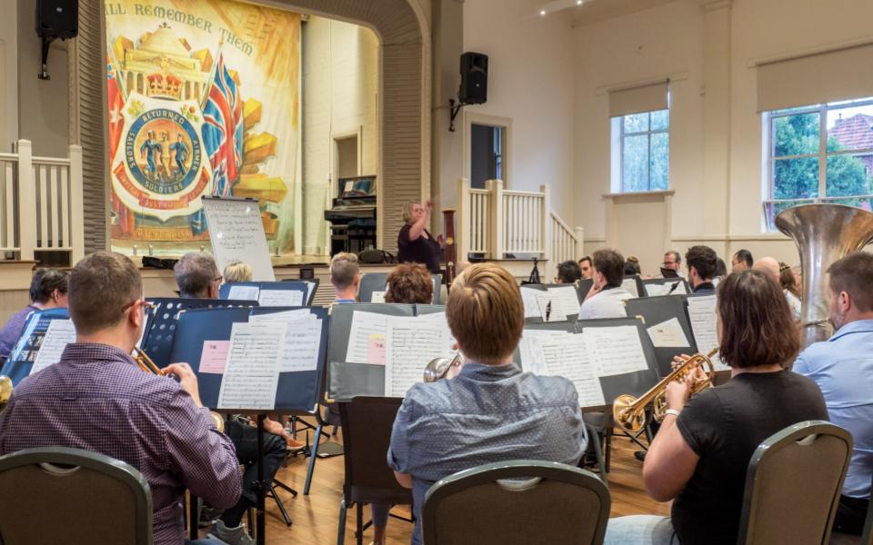
Thank you

